Slide 1

Starting out with Visual Basic®
Seventh Edition
Chapter 2
Creating Applications with Visual Basic
Copyright © 2017, 2014, 2011 Pearson Education, Inc. All Rights Reserved
Notes:
If this PowerPoint presentation contains mathematical equations, you may need to check that your computer has the following installed:
1) MathType Plugin
2) Math Player (free versions available)
3) NVDA Reader (free versions available)

Slide 2
Learning Objectives (1 of 2)
2.1 Getting Started with Forms and Controls
2.2 Creating the G U I for Your First Visual Basic Application: The Hello World Application
2.3 Writing the Code for the Hello World Application
2.4 More about Label Controls
2.5 Creating Multiple Event Handlers
2.6 Making Sense of IntelliSense
2.7 PictureBox Controls

Slide 3
Learning Objectives (2 of 2)
2.8 The Visible Property
2.9 Writing the Code to Close an Application’s Form
2.10 Comments, Blank Lines, and Indentation
2.11 Dealing with Errors
2.12 Displaying User Messages at Runtime
2.13 Customizing an Application’s Form
2.14 Using Visual Studio Help

Slide 4
2.1 Getting Started with Forms and Controls

Slide 5
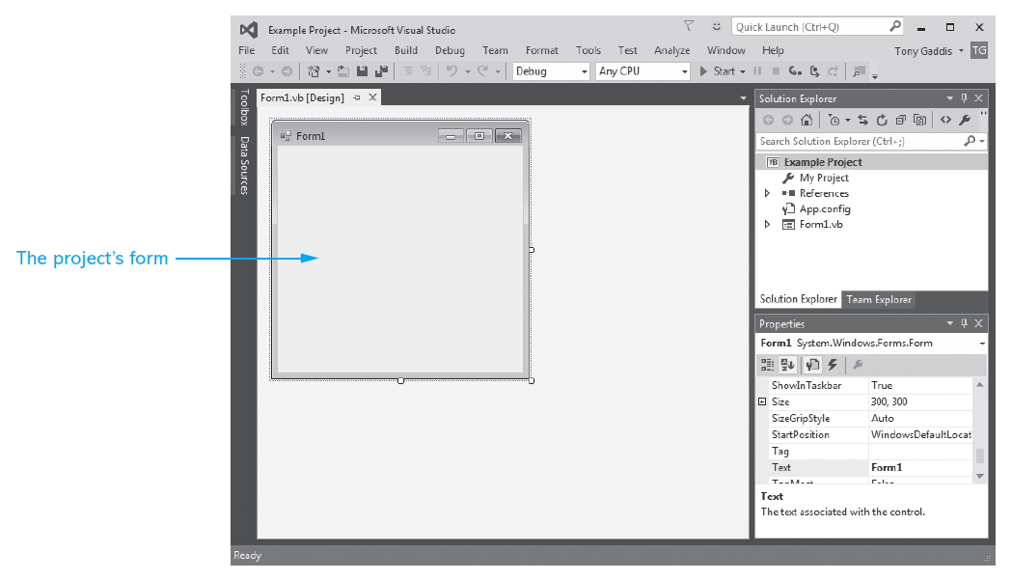
The Application Startup Form
Add controls to the form, change the form’s size, and modify many characteristics (properties)

Slide 6
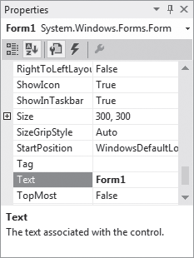
Using the Properties Window to Select Controls
The object box that appears at the top of the Properties window shows the name of the currently selected control
Clicking inside the object box displays a drop-down list showing the names of all objects on the form
Clicking the name of an object selects the object

Slide 7

Categorizing and Alphabetizing Properties
The Categorized and Alphabetical buttons affect the way properties are displayed
When the Alphabetical button
is selected
The properties are displayed in alphabetical order
Most of the time it is easier to locate properties that are listed in alphabetical order
Frequently used properties are enclosed in parentheses and appear at the top of the list
When the Categorized button
is selected
Related properties are displayed together in groups

Slide 8
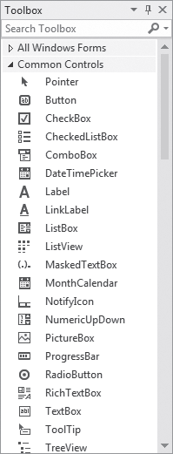
Adding Controls to a Form
The Toolbox
Shows a scrollable list of controls that you can add to a form
To add a control to a form, find it in the Toolbox and double-click it

Slide 9
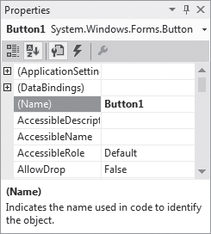
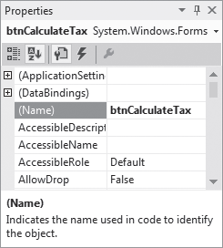
Name Property
Changing a Control’s Name
Change the control’s name to something more meaningful than the default name that Visual Studio gives it
The control’s name should reflect the purpose of the control
Button1 doesn’t convey a button’s purpose as well as b t n CalculateTax

Slide 10
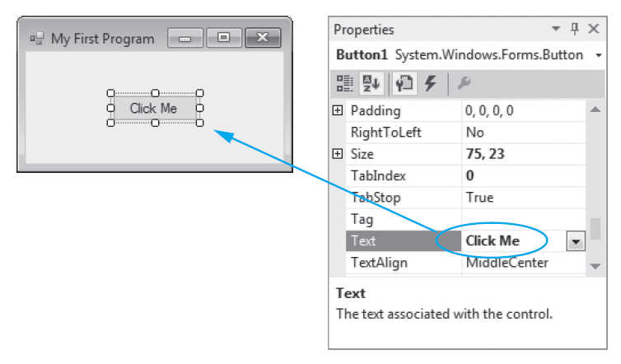
Text Property
Nearly every control has a Text property, which is initially equal to the same value as the control’s name.
The Name property and the Text property are not the same
A control’s Name property identifies the control in code and a control’s Text property determines the text the control displays on the screen.

Slide 11
2.2 Creating the G U I of Your First Visual Basic Application: The Hello World Application

Slide 12
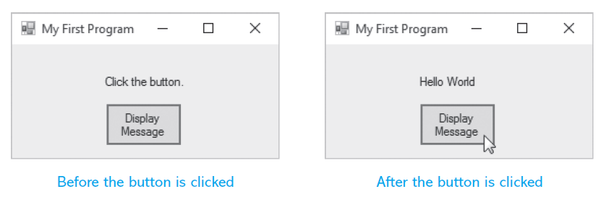

Event-Driven Hello World Program
A message box is a small pop-up message window
Sometimes referred to as a dialog box
A convenient way to display a message to the user
Displayed by calling the MessageBox.Show method
User clicks the Display Message button to remove the message box

Slide 13
Hello World Program Components (1 of 2)
The G U I for the Hello World application consists of three components:
A Form named Form1
A Button control named b t n DisplayMessage. The Purpose of the Button control is to cause the message Hello World to be displayed
A Label control named l b l Message. Initially, it, displays the text Click the button. When the user clicks the Button control, the Label control’s text changes to Hello World

Slide 14
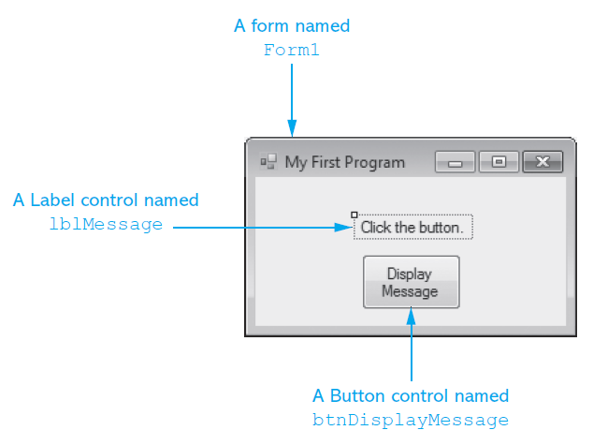
Hello World Program Components (2 of 2)

Slide 15
2.3 Writing the Code for the Hello World Application

Slide 16
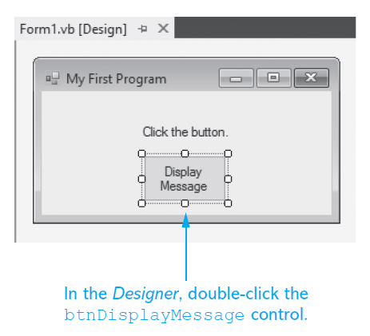
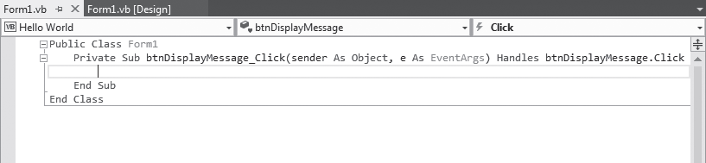
The Code Window
Double-clicking a control in design mode:
Opens the code window
Creates a code template for the control’s event handler where you fill in the code for the event

Slide 17
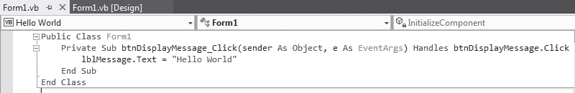
The Completed Click Event Handler
Assignment statements store values in a control’s properties
The equal sign (=) is known as the assignment operator
The value “Hello World” is a string, which is a piece of data containing a sequence of one or more characters

Slide 18
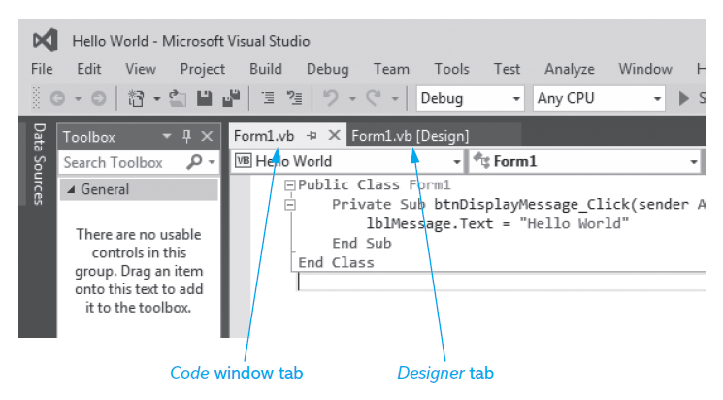
Switching Between the Code Window and the Designer Window
To switch to the Code window, click the tab that reads Form1.v b
To switch to the Designer window, click the tab that reads Form1.v b [Design]

Slide 19
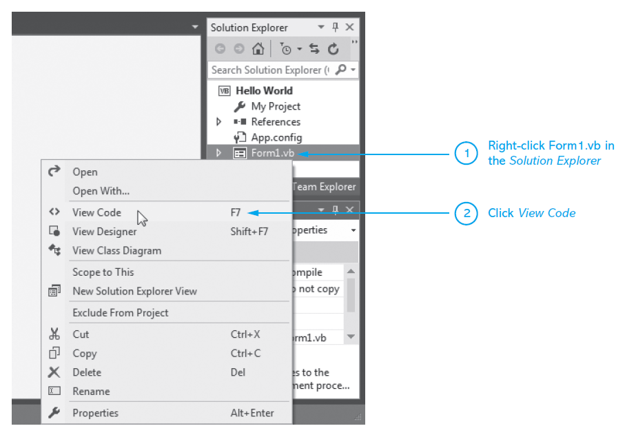
More Ways to Switch Between the Code Window and the Designer Window
Use the Solution Explorer to open the Code window
You can also perform any of the following actions:
Click View on the menu bar, then select either Code or Designer
Press Shift +F7 on the keyboard to open the Designer window
Press Ctrl + Alt + 0 to open the Code window

Slide 20
Design Mode, Run Mode, and Break Mode
Visual Basic has three modes in which it operates:
Design Mode
The mode in which you create the application
Also known as design time
Run Mode
Executes the application in the Visual Studio environment
Also known as runtime
Break Mode
Momentarily suspends execution of a running application
For testing and debugging purposes

Slide 21
How Solutions and Projects are Organized (1 of 2)
A solution is a container that holds Visual Studio projects
Each time you create a new project, you will also create a new solution to hold it
A solution folder is created for each new project
The solution folder contains:
The solution file and project folder
Double-clicking the solution file (.sln) will load the project in Visual Studio

Slide 22
How Solutions and Projects are Organized (2 of 2)
The project folder contains:
Several files and folders generated by Visual Studio
The project file
Double-clicking the project file (.v b p r o j) will also load the project in Visual Studio

Slide 23
Opening an Existing Project
With Visual Studio running, perform any one of the following actions:
Click File, then select Open Project
Locate either the solution file (.s l n) or the project file (.v b p r o j)
Click File, then select Recent Projects and Solutions
Select the solution file (.s l n) or project file (.v b p r o j) from the list
Use the Start page to open the project
If the Start page is not visible, click View, then select Start Page
Click the Open Project link or select the name of the project in the Recent Projects list

Slide 24
2.4 More About Label Controls

Slide 25
Label Controls
Label controls have various properties that affect the control’s appearance
Label controls are automatically given default names such as Label1, Label2, and so on.
A Label control’s Text property is initially set to the same value as the Label control’s Name
Select a Label control in Designer and use the Properties window to change its Text property

Slide 26
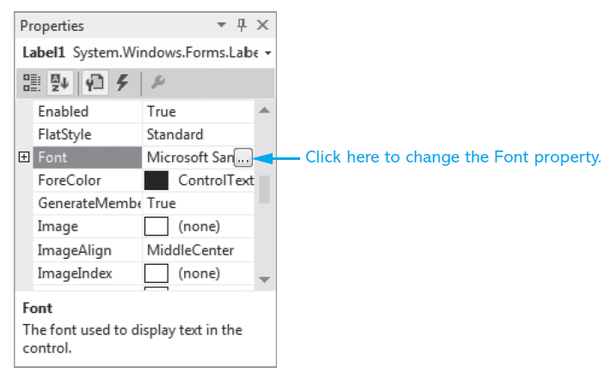
The Font Property
The Font property allows you to set the font, font style, and size of the control’s text.

Slide 27
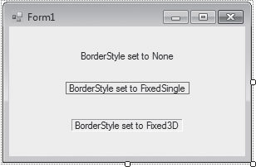
The BorderStyle Property
The Label control’s BorderStyle property determines the appearance of the label’s border and may have one of three values:
None (default) - The label will have no border
FixedSingle - The label will be outlined with a border one pixel wide
Fixed3D - The label will have a recessed 3D appearance

Slide 28
The AutoSize Property
AutoSize is a Boolean property
When set to True: (default)
The bounding box will automatically resize itself to fit the amount of text assigned to it
When set to False:
The label’s size may be changed in the Designer window with its sizing handles
The bounding box will remain the size it was given at design time
Text that is too large to fit in the bounding box will be only partially displayed

Slide 29
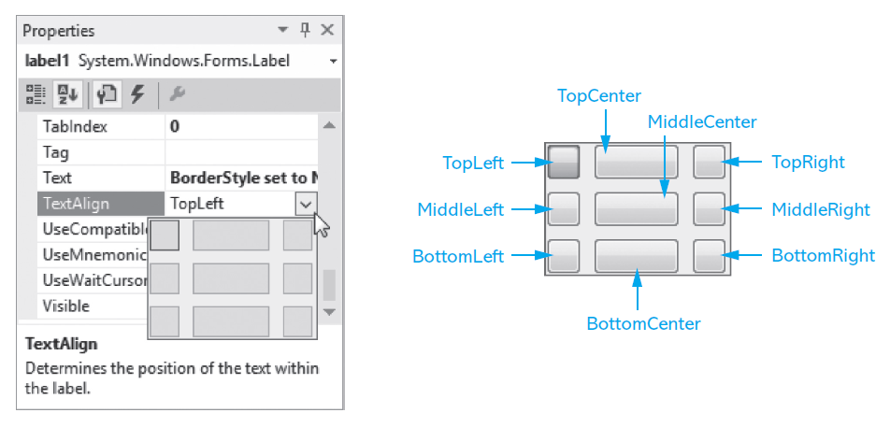
The TextAlign Property
The value of the TextAlign property changes the way a label’s text is aligned

Slide 30
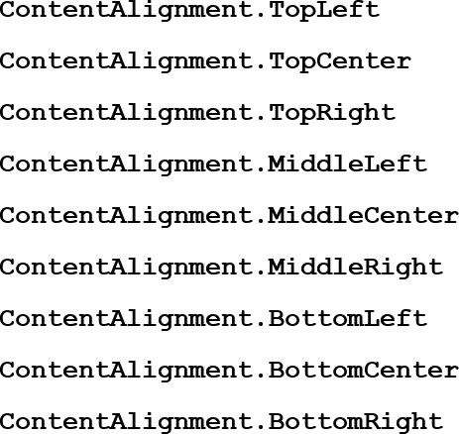
Changing a Label’s TextAlign Property with Code
You can use an assignment statement to assign one of the following values to the TextAlign property of a Label control:
For example:

Slide 31
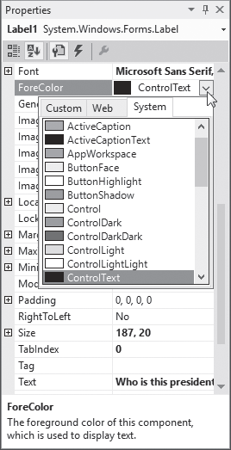
Changing Text Colors
The ForeColor property sets the text color
The BackColor property sets the background color
In the Properties window, select the control’s Color property, then click the
down-arrow button
that appears, then select a color from the list

Slide 32
Modifying a Control’s Text Property with Code
Suppose you have created a Label control and named it l b l Output. The following assignment stores the string “Thank you very much” in the control’s Text property:
When writing assignment statements, the item receiving the value must be on the left side of the = operator
A control’s Text property can accept strings only. You cannot assign a number to the Text property

Slide 33
Clearing a Label
In code, if you want to clear the text that is displayed in a Label control, assign an empty string (“”) to the control’s Text property, as shown here:
As an alternative, you can clear a Label control by assignming the special value String.Empty to the control’s Text property:

Slide 34
2.5 Creating Multiple Event Handlers

Slide 35
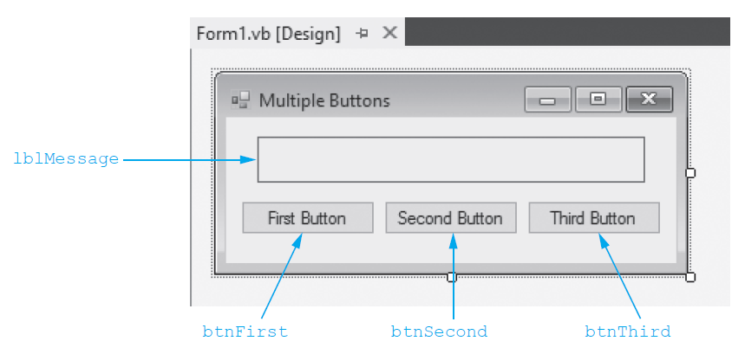
Multiple Button Controls (1 of 2)
Create Click event handlers for the buttons by double-clicking each Button control in the Designer and an empty event handler will be created in the form’s source code file.

Slide 36
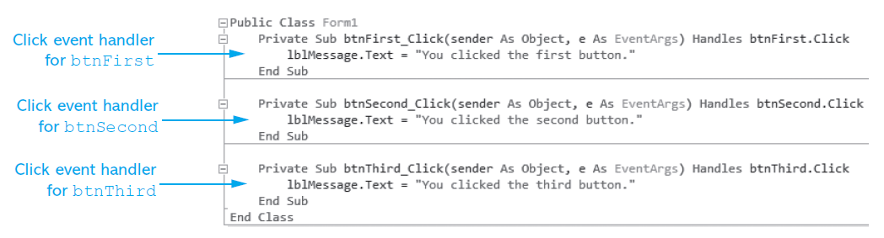
Code for Multiple Button Controls
Tutorial 2-3, Creating the Language Translator application, is an application with multiple buttons, each with its own Click event handler.

Slide 37
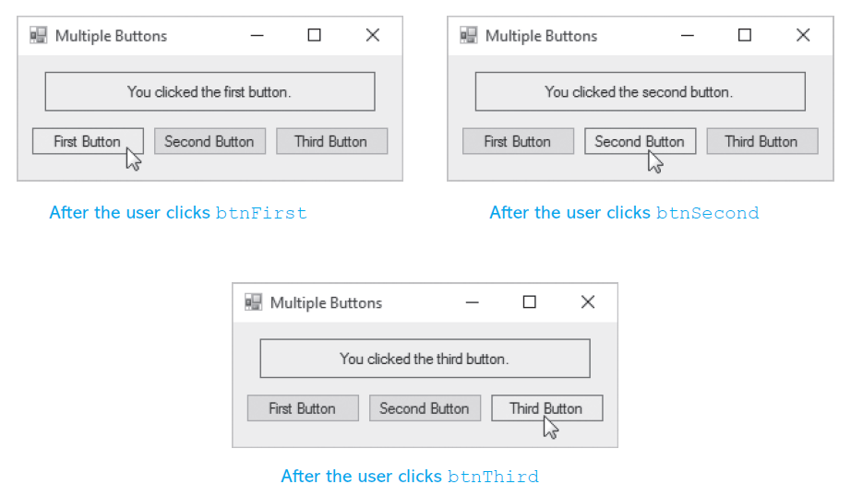
Multiple Button Controls (2 of 2)

Slide 38
2.6 Making Sense of IntelliSense

Slide 39
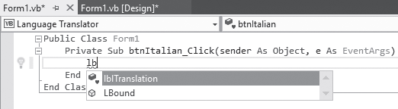
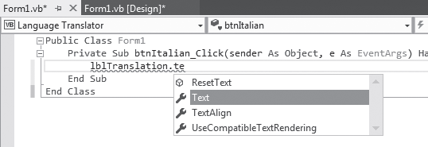
Using IntelliSense
IntelliSense is a feature that provides automatic code completion as you type programming statements
Press the Tab key to use IntelliSense
For Example:

Slide 40
2.7 PictureBox Controls

Slide 41
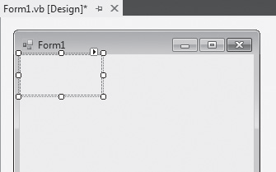
PictureBox Controls
A PictureBox control displays a graphic image on a form
In the Toolbox, the PictureBox tool is located in the Common Controls group
When you create PictureBox controls, they are automatically given default names such as PictureBox1, PictureBox2, and so forth. Change the default name to something more meaningful

Slide 42
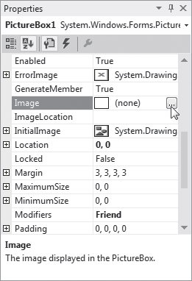
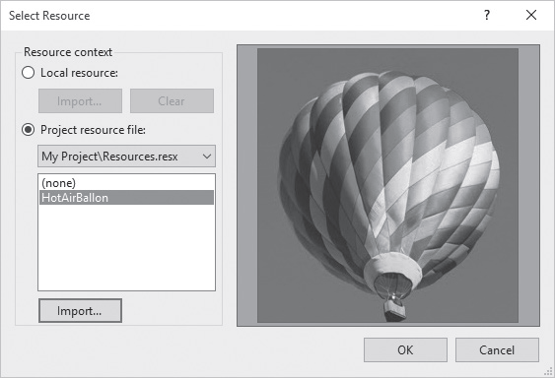
The Image Property’s Select Resource Window

Slide 43
The SizeMode Property (1 of 2)
When selecting an image using the Select Resource window, the image may partially displayed because the image is larger than the PictureBox control
The SizeMode property specifies how the image is to be displayed
Normal – This is the default. The image will be positioned in the upper-left corner. If the image is too large, it will be clipped

Slide 44
The SizeMode Property (2 of 2)
StretchImage – The image will be resized both horizontally and vertically to fit in the PictureBox control
AutoSize – The PictureBox control will be automatically resized to fit the size of the image
CenterImage – The image will be centered in the PictureBox control without being resized
Zoom – The image will be uniformly resized to fit the PictureBox without losing its original aspect ratio (width to height)

Slide 45
Writing Click Event Handlers for PictureBox Controls
Not only buttons, but many other controls such as PictureBoxes and Labels have Click event handlers
As we saw earlier, the Image Property can be set to a graphic image of some sort
The Click event can be handled by code to take whatever action is desired
The flag images in Tutorial 2-5 are clickable

Slide 46
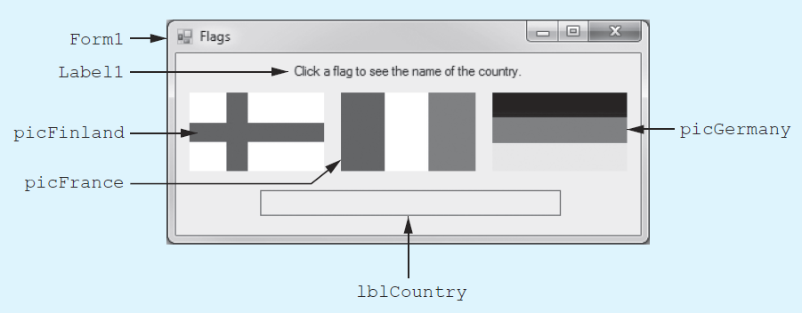
Tutorial 2-5: The Flags Project
This application displays the flags of Finland, France, and Germany in PictureBox controls
When the user clicks any of these PictureBoxes, the name of that flag’s country will appear in a Label control

Slide 47
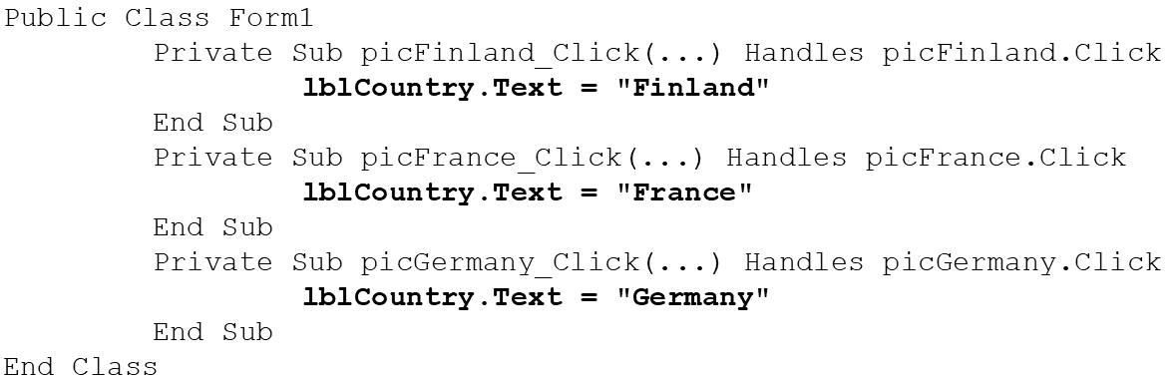
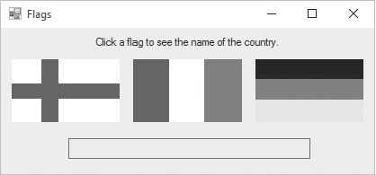
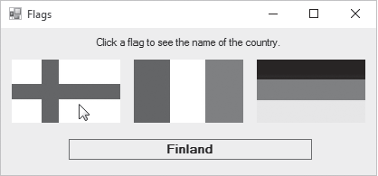
PictureBox Click Event Handler
When PictureBox p i c Finland is clicked, the l b l Country Text property is set to display Finland

Slide 48
2.8 The Visible Property

Slide 49
The Visible Property
A control’s Visible property determines if the control is visible on the form at runtime
The Visible property is a Boolean property (values True or False)
By default, the Visible property is set to True for all controls

Slide 50
2.9 Writing the Code to Close an Application’s Form

Slide 51
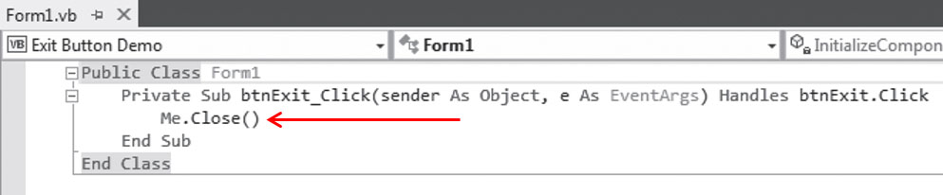
Ending an Application with Me.Close()
An application’s form is an object that has a method named Close
When a form’s Close method is called, it causes the form to close
If the application has only one form, it also ends the application
Oftentimes, the statement will be used in the Click event handler of an Exit button
For example:

Slide 52
2.10 Comments, Blank Lines, and Indentation

Slide 53

Comments
Comments, or remarks, are short notes you can add to your application’s code to explain its meaning
A comment starts with an apostrophe (')
Anything appearing after the apostrophe, to the end of the line, is ignored by the compiler
A comment can also be inserted at the end of a programming statement

Slide 54
Blank Lines and Indentation
Programmers commonly use blank lines and indentations in their code to create a sense of visual organization
For example, you should insert blank lines to visually separate your code into groups of related statements. This makes it easier to read.
Indentation helps to organize all statements appearing inside event handlers
Visual Studio automatically indents your code

Slide 55
2.11 Dealing with Errors

Slide 56
Errors
In general, there are three types of errors:
Syntax errors
Runtime errors
Logic errors
The compiler reports syntax errors, but runtime and logic errors can be found only through the process of testing and debugging the program

Slide 57
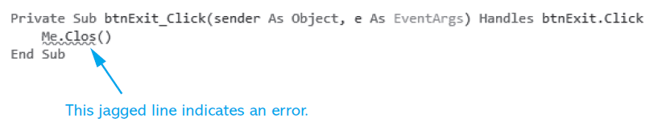
Syntax Errors (1 of 2)
Often, syntax errors are small mistakes like misspelled keywords, or incorrect use of operators and punctuation
Visual Basic informs you of these errors as soon as the code is entered
The error location will be underlined with a jagged blue line, as shown here:

Slide 58
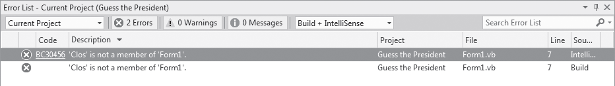
Syntax Errors (2 of 2)
A description of the error is shown in the Error List window
To display this window, select View on the menu bar, and then select Error List (see below)
Double-click the error message to position the cursor at the error in the Code window

Slide 59
Runtime Errors
Some errors occur when your program executes
these are not the same as syntax errors, which appear when the code is entered by the programmer
Runtime errors occur when Visual Basic attempts to perform an operation that cannot execute
for example, when a program tries to read data from a file that does not exist
Runtime errors usually cause a program to abruptly halt and display an error message

Slide 60
Logic Errors
Logic Errors produce the wrong results, or cause a program to behave in an unexpected manner
they occur while a program is running
A program might have no syntax errors, but, if it has incorrect logic, it will not do what it is supposed to do
To find these errors, debug the application
A debugger is a tool that lets you step through a program, or part of a program, executing its code one line at a time
As you execute each line of code, you can observe the data that the program stores in memory, as well as the values of control properties

Slide 61
2.12 Displaying User Messages at Runtime

Slide 62
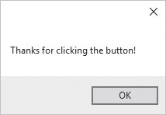
Displaying Message Boxes
A message box is a small window, sometimes referred to as a dialog box, that displays a message
The message box below also has an OK button. When the user clicks the OK button, the message box closes

Slide 63
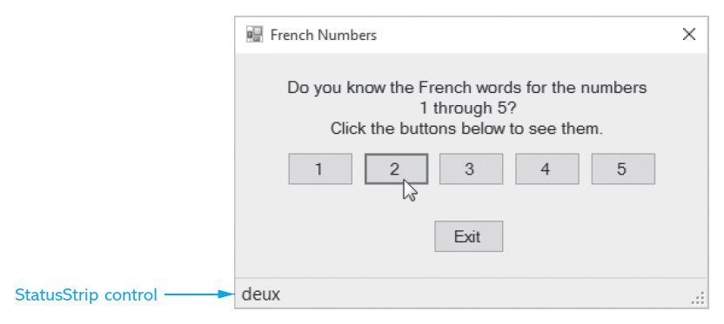
The StatusStrip Control
The StatusStrip control, which is similar to a Label, is used to display program status information and messages to the user
An ideal way to display messages that are not system critical
Does not force the user to click a button to clear the message

Slide 64
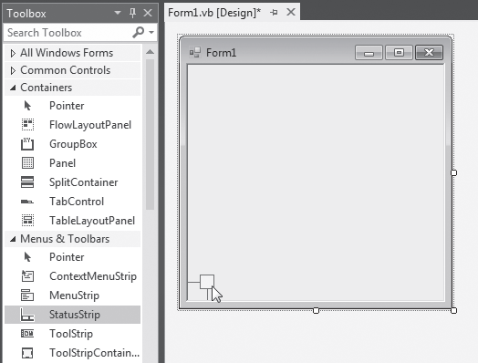
Adding a StatusStrip and a Label to a Form (1 of 2)
Step 1:
Drag the StatusStrip control from the Menus & Toolbars section of the Toolbox window onto an existing form.
The StatusStrip will attach itself to the bottom of the form
This is called docking the control

Slide 65
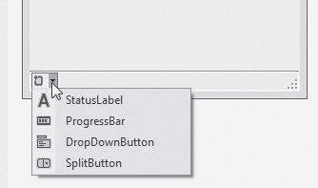
Adding a StatusStrip and a Label to a Form (2 of 2)
Step 2:
Click the down arrow on the left side of the StatusStrip and then select StatusLabel from the drop-down list
A ToolStripStatusLabel control will be added to the StatusStrip
Set its Name property with a more meaningful name
Clear its Text property

Slide 66
2.13 Customizing an Application’s Form

Slide 67
Changing the Form’s Appearance (1 of 2)
The FormBorderStyle Property controls the appearance of the form’s border and determines whether the user can resize the form
Setting | Description
None | The form has no border.
FixedSingle | The form is not resizable, and uses a border that is a single line. The form is displayed with Minimize, Maximize, and Close buttons on its title bar. Although the form may be maximized and minimized, it may not be resized by its edges or corners.
Fixed3D | The form is not resizable and uses a border that has a 3D appearance. The form is displayed with Minimize, Maximize, and Close buttons on its title bar. Although the form may be maximized and minimized, it may not be resized by its edges or corners.

Slide 68
Changing the Form’s Appearance (2 of 2)
Setting | Description
FixedDialog | The form is not resizable. It is displayed with Minimize, Maximize, and Close buttons on its title bar. Although the form may be maximized and minimized, it may not be resized by its edges or corners.
Sizable | This is the default setting for FormBorderStyle. The form is displayed with Minimize, Maximize, and Close buttons on its title bar. The form may be resized, but the controls will not move unless you set certain property values.
FixedToolWindow | The form is not resizable. It is displayed with only a Close button. The text that is displayed in the title bar appears in a reduced font size.
SizeableToolWindow | The form is not resizable. It is displayed with only a Close button. The text that is displayed in the title bar appears in a reduced font size.

Slide 69
MinimizeBox, MaximizeBox, and ControlBox (1 of 2)
The MinimizeBox Property (Boolean)
Hides the Minimize button
when set to False
Is disabled but shown if MaximizeBox is set to True
The MaximizeBox Property (Boolean)
Hides the Maximize button
when set to False
Is disabled but shown if MinimizeBox is set to True

Slide 70
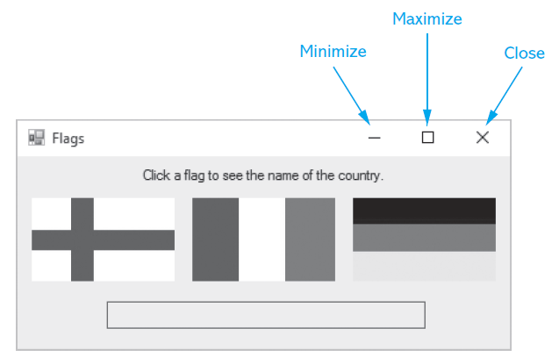
MinimizeBox, MaximizeBox, and ControlBox (2 of 2)
The ControlBox Property (Boolean)
Hides all buttons when set to False
Overrides the values of MinimizeBox and MaximizeBox

Slide 71
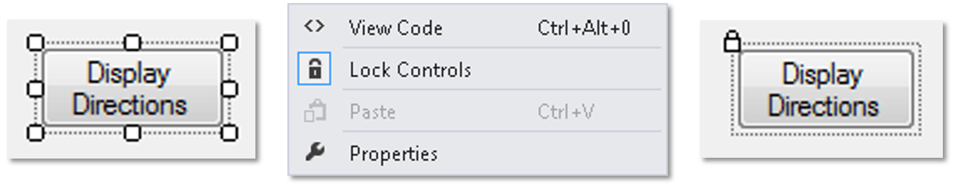
Locking Controls
Locking controls prevents them from being moved around during design time
To lock controls:
Right-click an empty space on the form
Select Lock Controls from the menu

Slide 72
2.14 Using Visual Studio Help

Slide 73
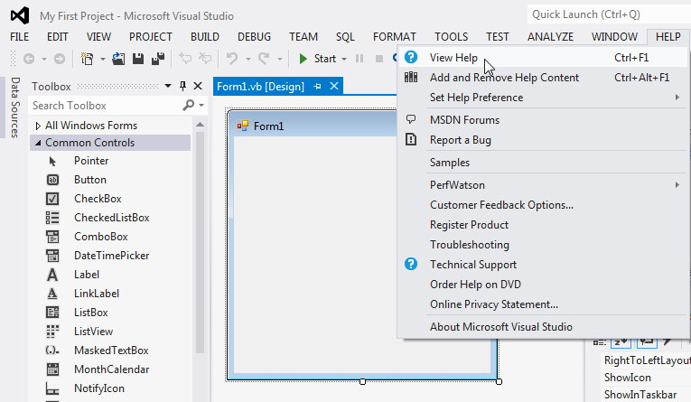
Accessing the Visual Studio Documentation

Slide 74
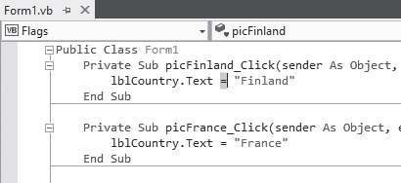
Context-Sensitive Help
Context-sensitive help is help on a single topic that you are currently working on
First select an item you need help with in Visual Studio
Then press the F1 key on the keyboard
This launches a help screen in your Web browser

Slide 75
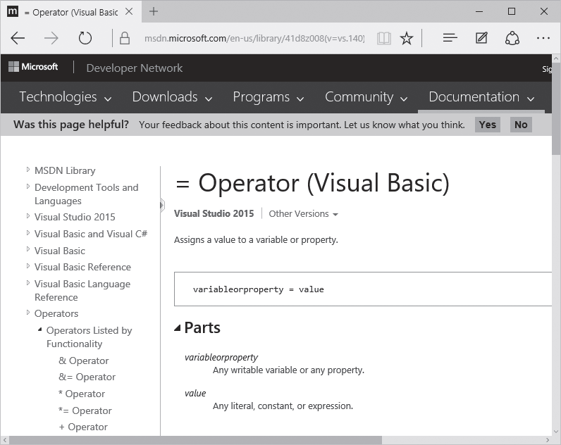
Help on the = Operator

Slide 76

Copyright

